Slide 1
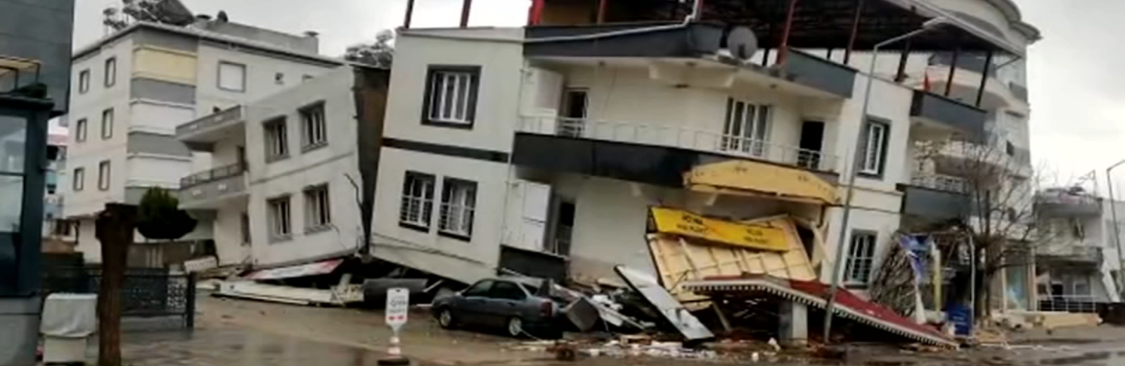
Richter's Predictor: Modeling Earthquake Damage
T Bharadwaj

Slide 2
Problem statement
After the recent earthquakes in Turkey and Syria one of the topics of interest is how to investigate earthquake damage on buildings post an earthquake
As I started to research I came across this problem and the dataset through an competition hosted by Driven Data
In this project we are trying to predict the ’damage grade’, which represents the level of damage to a building that was hit by the earthquake. There are 3 grades of the damage:
1 represents low damage
2 represents a medium amount of damage
3 represents almost complete destruction

Slide 3
Objective
Following an earthquakes event, a lot of field investigations on damage to buildings are carried out, due to enormous amount of buildings and there varieties, it becomes a difficult task to investigate each of the building affected post earthquake. Hence, through this project we are trying to build a model that can help us determine the level of damage caused to a building when we are having a certain level of description about the building

Slide 4
Methodology
Data Collection
The dataset was taken through an competition hosted by Driven Data
Data Preparation
Preprocess the dataset by removing any duplicates, missing values, or inconsistent data.
Model Selection
Choose a suitable machine learning algorithms to train the model
Feature Engineering
Analyze the dataset and extract relevant features that are likely to impact earthquake damage
Transform and scale the features appropriately, for example, by standardizing or normalizing them.
Model Training
Train the selected model using the prepared dataset
Use appropriate techniques to prevent overfitting, such as regularization, early stopping, or dropout Use appropriate techniques to prevent overfitting, such as regularization, early stopping, or dropout.
Model Evaluation
Evaluate the performance of the trained model on the testing set
Use appropriate metrics, such as F1 square, Precision, Recall, to measure the model's accuracy and generalization ability.

Slide 5
About the dataset
Following the 7.8 Mw Gorkha Earthquake on April 25, 2015, Nepal carried out a massive household survey using mobile technology to assess building damage in the earthquake-affected districts.
The data was collected through surveys by Kathmandu Living Labs and the Central Bureau of Statistics, which works under the National Planning Commission Secretariat of Nepal
The dataset mainly consists of information on the buildings structure and their legal ownership. Each row in the dataset represents a specific building in the region that was hit by Gorkha earthquake.
There are 39 columns in this dataset and around 260000 rows

Slide 6
Feature description
geo_level_1_id, geo_level_2_id, geo_level_3_id (type: int): geographic region in which building exists, from largest (level 1) to most specific sub-region (level 3). Possible values: level 1: 0-30, level 2: 0-1427, level 3: 0-12567
count_floors_pre_eq (type: int): number of floors in the building before the earthquake
age (type: int): age of the building in years
area_percentage (type: int): normalized area of the building footprint
height_percentage (type: int): normalized height of the building footprint
land_surface_condition (type: categorical): surface condition of the land where the building was built. Possible values: n, o, t
foundation_type (type: categorical): type of foundation use while building. Possible values: h, i, r, u, w.
roof_type (type: categorical): type of roof used while buildin. Possible values: n, q, x.
ground_floor_type (type: categorical): type of the gr=ound floor. Possible values: f, m, v, x, z.

Slide 7
other_floor_type (type: categorical): type of constructions used in higher than the ground floors (except of roof). Possible values: j, q, s, x.
position (type: categorical): position of the building. Possible values: j, o, s, t.
plan_configuration (type: categorical): building plan configuration. Possible values: a, c, d, f, m, n, o, q, s, u.
has_superstructure_adobe_mud (type: binary): flag variable that indicates if the superstructure was made of Adobe/Mud.
has_superstructure_mud_mortar_stone (type: binary): flag variable that indicates if the superstructure was made of Mud Mortar - Stone.
has_superstructure_stone_flag (type: binary): flag variable that indicates if the superstructure was made of Stone.
has_superstructure_cement_mortar_stone (type: binary): flag variable that indicates if the superstructure was made of Cement Mortar - Stone.
has_superstructure_mud_mortar_brick (type: binary): flag variable that indicates if the superstructure was made of Mud Mortar - Brick.
has_superstructure_cement_mortar_brick (type: binary): flag variable that indicates if the superstructure was made of Cement Mortar - Brick
has_superstructure_timber (type: binary): flag variable that indicates if the superstructure was made of Timber
has_superstructure_bamboo (type: binary): flag variable that indicates if the superstructure was made of Bamboo
has_superstructure_rc_non_engineered (type: binary): flag variable that indicates if the superstructure was made of non-engineered reinforced concrete.

Slide 8
has_superstructure_rc_engineered (type: binary): flag variable that indicates if the superstructure was made of engineered reinforced concrete.
has_superstructure_other (type: binary): flag variable that indicates if the superstructure was made of any other material
legal_onership_status (type: categorical): legal ownership status of the land where building was built. Possible values: a, r, v, w.
count_families (type: int): number of families that live in the building.
has_secondary_use (type: binary): flag variable that indicates if the building was used for any secondary purpose.
has_secondary_use_agriculture (type: binary): flag variable that indicates if the building was used for agricultural purposes
has_secondary_use_hotel (type: binary): flag variable that indicates if the building was used as a hotel.
has_secondary_use_rental (type: binary): flag variable that indicates if the building was used for rental purposes
has_secondary_use_institution (type: binary): flag variable that indicates if the building was used as a location of any institution.

Slide 9
has_secondary_use_school (type: binary): flag variable that indicates if the building was used as a school
has_secondary_use_industry (type: binary): flag variable that indicates if the building was used for industrial purposes
has_secondary_use_health_post (type: binary): flag variable that indicates if the building was used as a health post.
has_secondary_use_gov_office (type: binary): flag variable that indicates if the building was used fas a government office.
has_secondary_use_use_police (type: binary): flag variable that indicates if the building was used as a police station.
has_secondary_use_other (type: binary): flag variable that indicates if the building was secondarily used for other purposes.

Slide 10
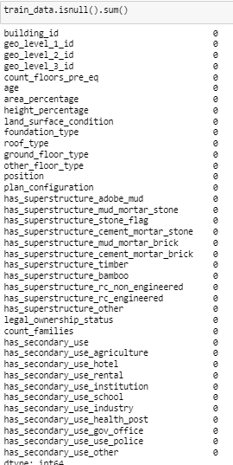
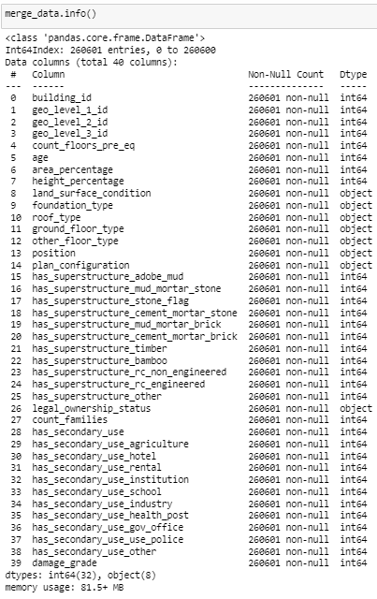
Data preparation
No missing values
40 columns after merging with train_labels and there Dtype

Slide 11
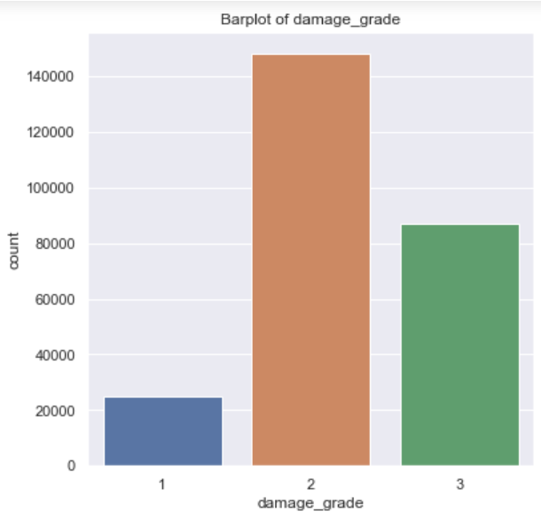
EDA
Majority of the building in Nepal had a medium and high level damage following the earthquake, with only few buildings having low damage grade level
It is important to note that we have to balance this data so as to use models like decision tress and random forests as these models are extremely sensitive towards imbalanced data
Plot 1
Distribution of target/dependent variable, damage_grade

Slide 12
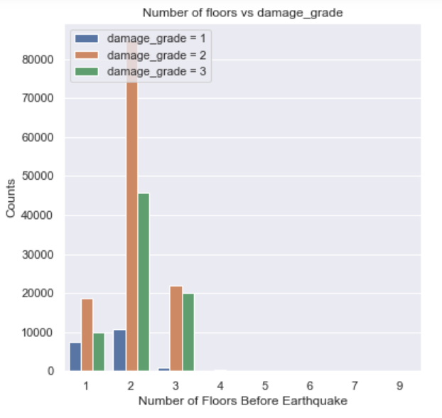
Relationships of target variable with other variables
Majority of the damage happend to the buildings with 2 floors.
Although there are buildings with 9 floors but it seems that these buildings did not suffer much damages compared to building with 1,2 and 3 floors. One reason may be because these were Highrise buildings hence much caution must have been taken with respect to the quality of materials used and design of the buildings
Plot 2

Slide 13
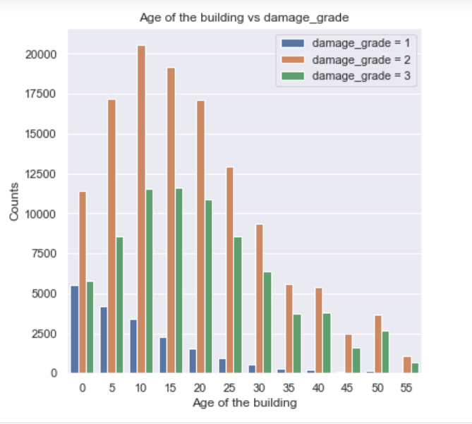
All the building suffered damage irrespective of the age of the building
There are significant number of houses with zero age. These either may be new buildings or maybe missing data
All the buildings above 30 years had only damage grade of either 2 or 3. This implies that age has a major factor in determining the level of damage that is going to affect the building
Plot 3

Slide 14
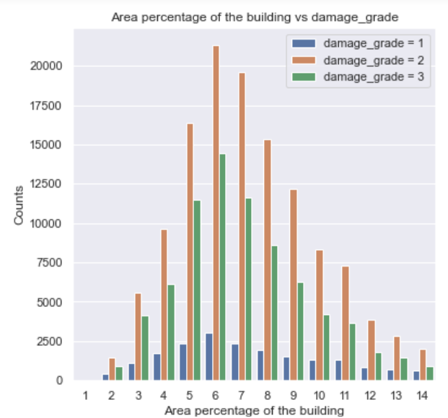
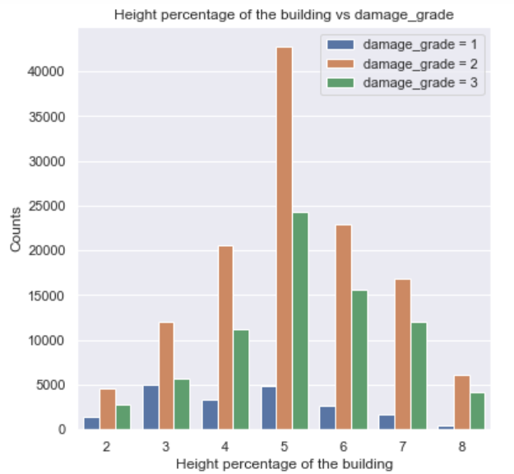
Plot 4
Plot 5
From both plot 4 and plot 5 we can see that most of the damages are damage grade 2 and damage grade 3

Slide 15
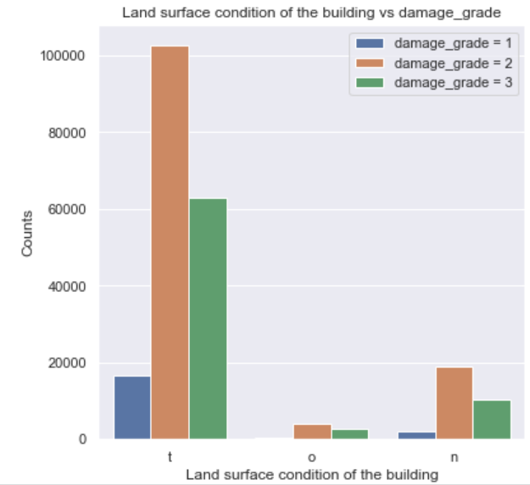
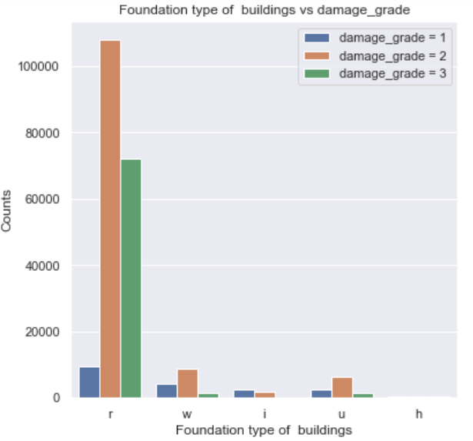
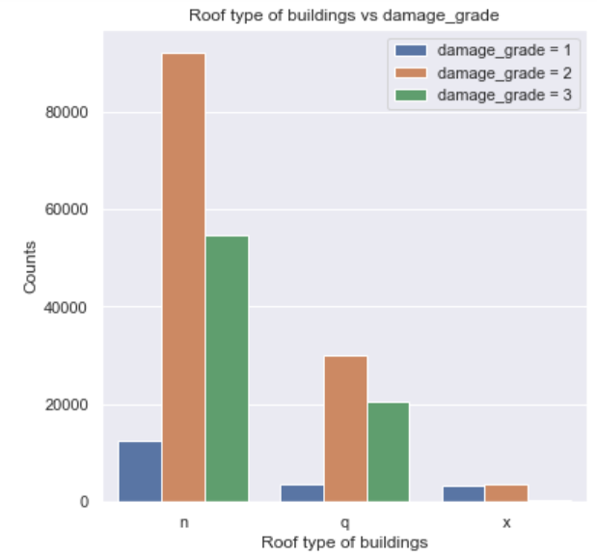
Plot 6
Plot 7
Plot 8
Looking at the land surface condition of the building, the type T has a significant impact on the severity of damage on the building
Looking at the foundation type, we can observe that floor type of the value R has a significant impact on the severity of damage on the building
Looking at the roof type, we can observe that roof type of the value R has a significant impact on the severity of damage on the building

Slide 16
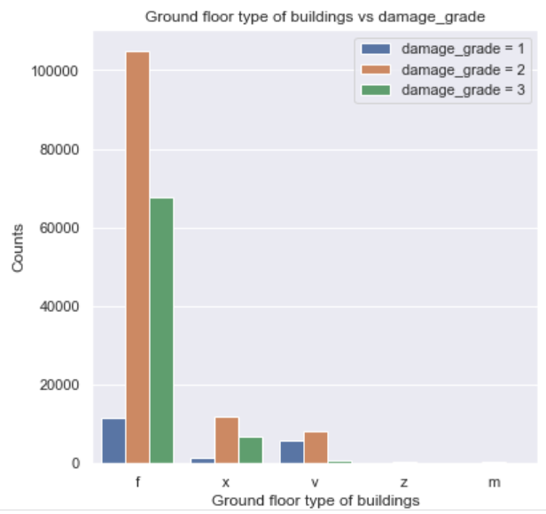
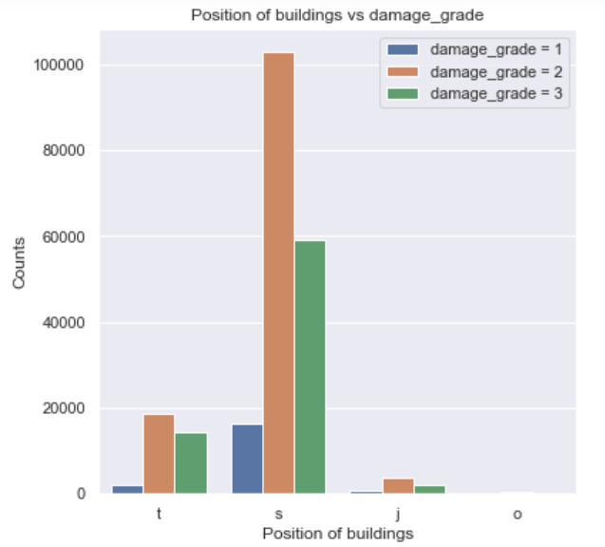
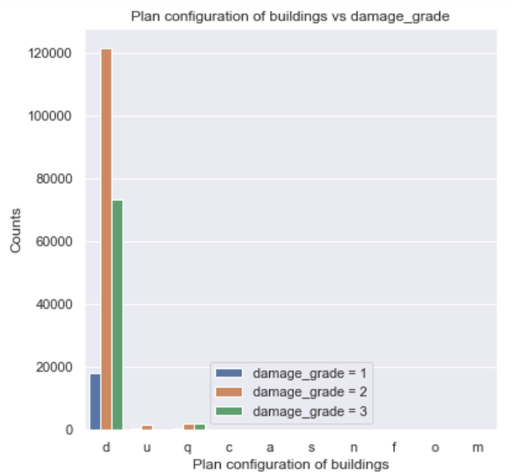
Plot 9
Plot 10
Plot 11
Looking at the ground floor type of the building, the type f has a significant impact on the severity of damage on the building
Looking at the position, we can observe that position of building of type o had no damage to the buildings
Looking at the plan configuration type, we can observe that plan configuration type of the value d has a significant impact on the severity of damage on the building

Slide 17
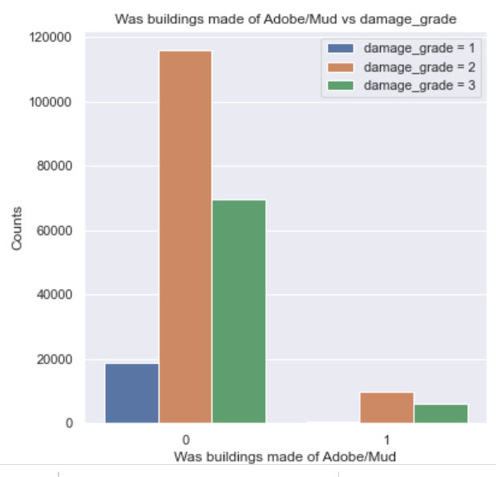
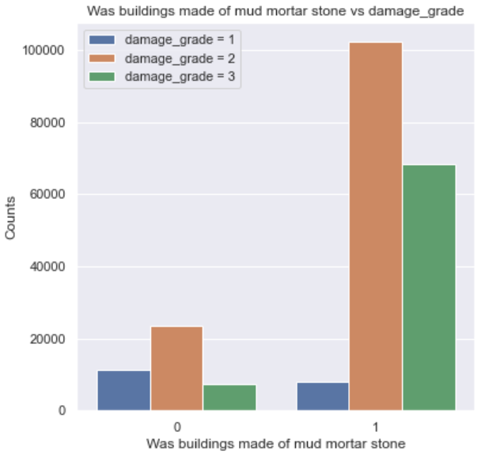
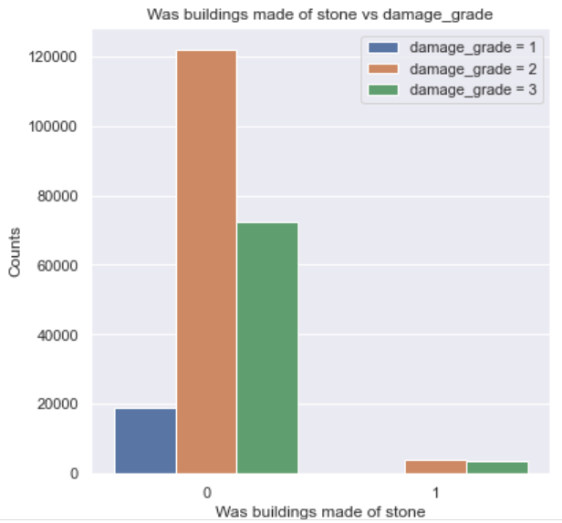
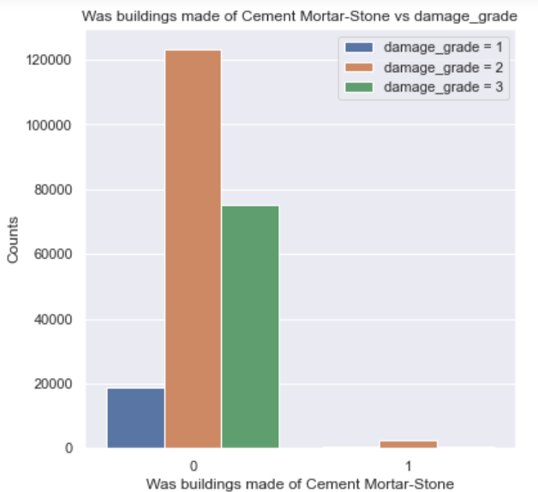
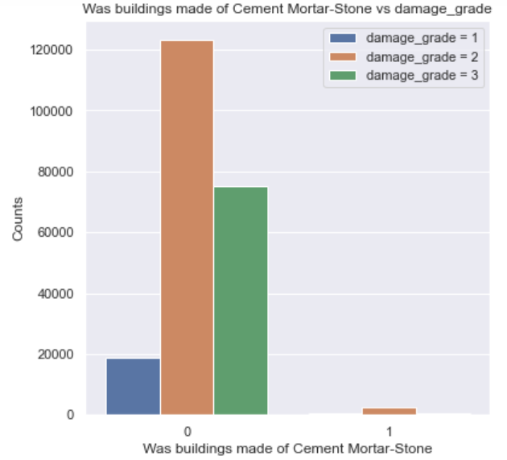
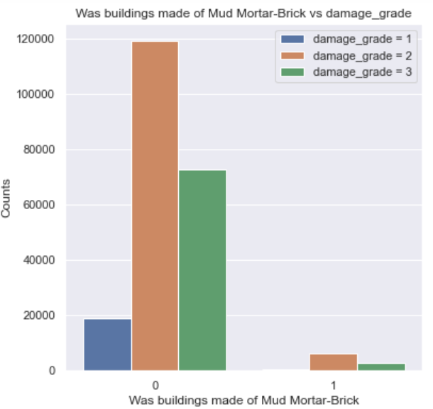

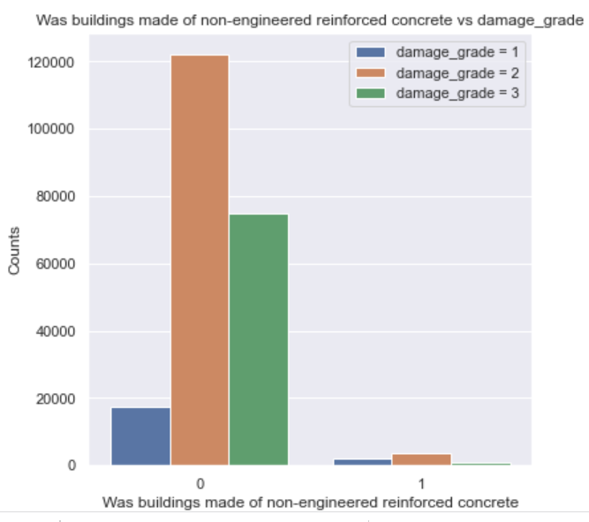
Plot 12
Plot 13
Plot 14
Plot 15
Plot 16
Plot 17
Plot 18
Plot 19
Effect of damage on building based on the materials used for construction

Slide 18
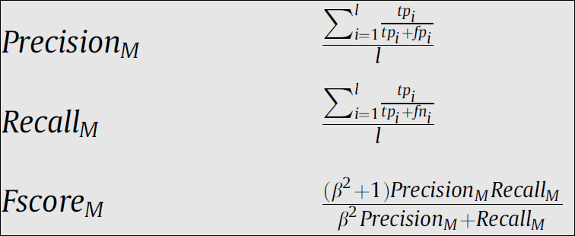
Data modeling
This stage involves training a machine learning model with all the given features to make predictions for the target variable Damage_Grade.
To measure the performance of our algorithms, we’ll use the F1 score which balances the precision and recall of a classifier. Traditionally, the F1 score is used to evaluate performance on a binary classifier, but since we have three possible labels we will use a variant called the macro averaged F1 score or accuracy score

Slide 19
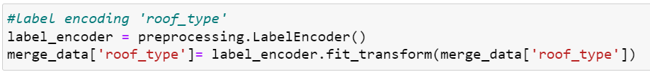
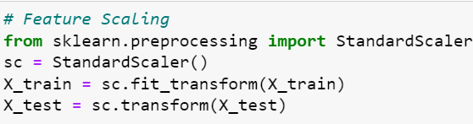
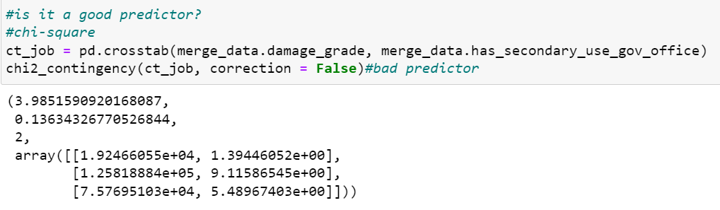
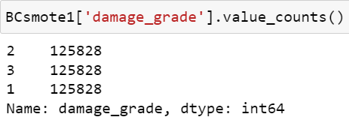
Before the model is fitted on the data necessary feature transformation was performed on the data which include the following;
Feature scaling
Converting categorical columns into numerical using label encoding
Dropping features based on statistical tests like ANNOVA and CHI-SQUARE tests
SMOTE to balance the imbalanced target variable

Slide 20
Finally the data was split into train and test data and the followings models were used in the project:
Logistic classification(with and without SMOTE)
Random Forests(with and without SMOTE)
Decision Tree
Adaptive Boosting
GradBoost
KNN
Naïve Bayes

Slide 21
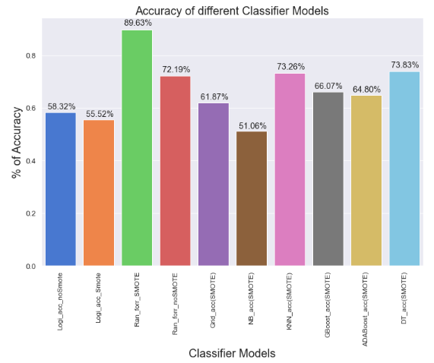
Plot 19
It is clear from the above plot that Random Forest with SMOTE gives the best accuracy

Slide 22
How Helpful is it?
Risk assessment: Businesses can use the model to assess the potential risk of damage to their properties or facilities in earthquake-prone areas. This can help them make informed decisions about whether to invest in earthquake-resistant construction, relocate their operations, or purchase insurance coverage.
Disaster planning: The model can also be used to develop disaster response plans in the event of an earthquake. By estimating the potential damage and impact of an earthquake, businesses can prepare emergency procedures, evacuation plans, and other measures to minimize the impact on their employees, customers, and assets.
Investment decisions: Investors can also use the model to evaluate potential investment opportunities in earthquake-prone areas. By estimating the potential damage and cost of earthquakes, investors can make more informed decisions about whether to invest in businesses or properties in those areas.

Slide 23


